Slide 1
Green Entrepreneurs Europe (GEE)
“The European Commission support for the production of this publication does not constitute an endorsement of the contents which reflects the views only of the authors, and the Commission cannot be held responsible for any use which may be made of the information contained therein."
Self-guided teacher training for delivering the GEE project at your school
The FSC are the educational partners of the GEE project in the UK.
BITC are the business partners of the GEE project in the UK.

Slide 2
Welcome!
Welcome to the self-guided teacher training programme for the Erasmus+ Green Entrepreneurs Europe programme.
This guide will introduce you to some key concepts in the project, explain the rationale and pedagogy behind the project, introduce you to the modules and hopefully inspire you to run the Green Entrepreneurs Europe project at your school.
The guide is interactive and you are encouraged to do the activities and watch the videos to get the most out of this training.
Please read this guide in conjunction with materials on the project website at:
https://www.geelearning.eu
The website contains all the downloads that you will need to run this project at your school, as well as other information and updates about the project.
* Please also look at the notes part accompanying each slide

Slide 3
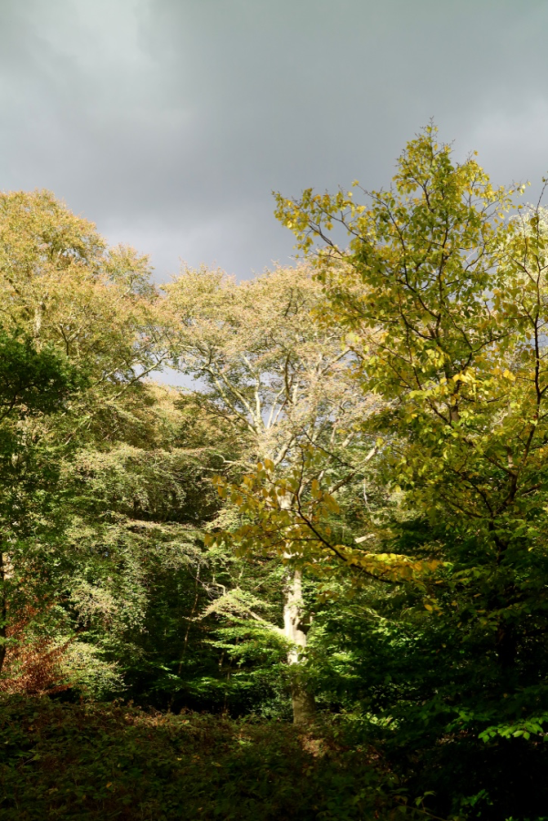
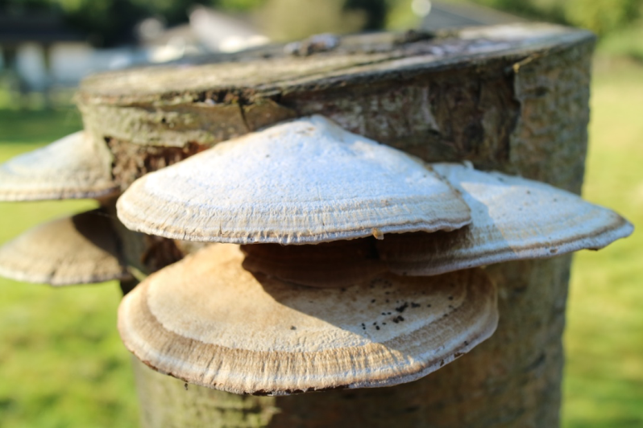
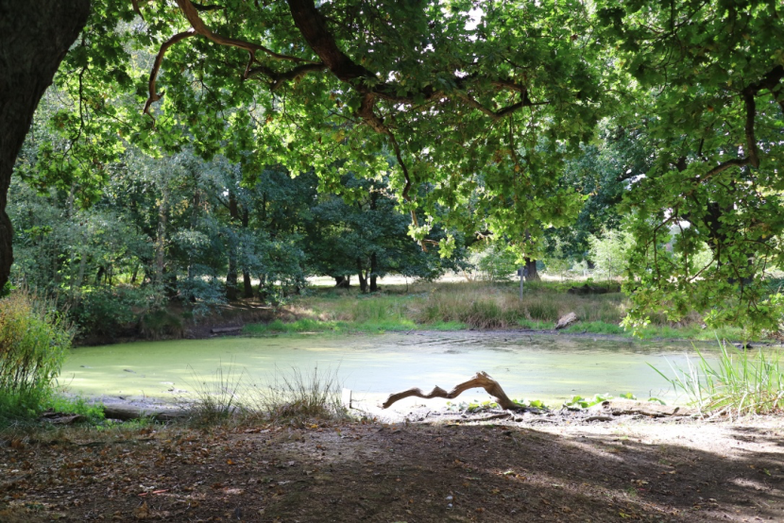
Outline
Welcome
How is the project relevant to schools?
Why is green entrepreneurship important?
GEE project: background, priorities and objectives
GEE thinking
GEE pedagogy
Learning materials
Assessment
Website
Further reading & uselful links
Images: Yanika Hennig

Slide 4
How is the project relevant to schools?
The GEE project is aimed at UK Secondary schools with KS3 students.
It’s cross disciplinary and has curriculum links with Science, Geography, Business, DT & PSHE)
Aims to make the world of work interesting and meaningful to pupils by linking entrepreneurship to the green economy
Everything is provided to teach the project: differentiated lesson plans with AFL techniques and resources, assessment techniques and in depth guides with links, suggestions and contacts.
Uses real world examples and provides the opportunity to meet experts in their field.
One day is taught outside which pilot schools said was a highlight of the project.
The project has a positive message for the young people it is aimed at. Rather than: “do less bad” (eg consume less, drive less etc), it’s about “doing good” (consume products which can be re-used, drive cars which don’t emit pollutants etc).
Notes:
The Green Entrepreneurs Europe project was a 3 year funded project running from 2015- 2018. It involved educational and business partners in the UK, Spain, Latvia, Romania and Bulgaria. Working collaboratively, each partner country developed the learning materials and website for their country. Learning materials were piloted in Secondary Schools and feedback from teachers was used to improve the project. The project funding ended in August 2018. Now al the materials are freely available on the from website to be downloaded by teachers and used in school. See www.geelearning.eu

Slide 5
Why is green entrepreneurship relevant/ important?
GEE (Green Entrepreneurs Europe) aims at developing the competencies of schools and teachers to provide meaningful entrepreneurship learning for the green economy. A sense of initiative and entrepreneurship is an essential transversal skill identified by the EU both to create jobs in the future and in the transformation towards a green economy. In moving towards these goals we need to increase the relevance and attainment levels of pupils studying entrepreneurship.
GEE seeks to provide learning for pupils based in the real world of business and entrepreneurship, to enable them to turn ideas into action. By focusing on the skills and competencies for the green economy, GEE invites schools, teachers and pupils to think more creatively and innovatively about how they can develop entrepreneurial ideas that provide jobs and conserve the natural world we depend upon.

Slide 6
GEE project: background, priorities and objectives

Slide 7
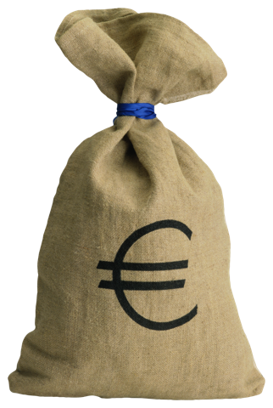
Green Entrepreneurs Europe
Priorities:
Developing basic and transversal skills using innovative methods
Increasing attainment levels
Promoting entrepreneurship education and social entrepreneurship among young people.
Rationale:
Europe needs more young people with green entrepreneurship skills if it is to achieve its EU2020 target of ‘Sustainable growth - for a resource efficient, greener and more competitive economy
Within the scope of formal education, studies have shown that teachers are often the key agents of change when it comes to moving entrepreneurship education reforms forward.
The green economy is an increasing source of jobs in Europe (CEDEFOP) and Eurobarometer (2013) reports that green skills in SMEs are increasing with 4/10 employing at least one full-time employee working in a green job. Recent research shows that start-up rates increase by as much as 20% when entrepreneurship lessons are provided in schools.
Whether or not they go on to start their own businesses or social enterprises, young people who benefit from entrepreneurial learning develop business knowledge and essential skills and attitudes including creativity, initiative, tenacity, teamwork, understanding of risk and a sense of responsibility. This is the entrepreneurial mind-set that helps entrepreneurs transform ideas into action and also significantly increases employability. This is the need GEE seeks to address.
Images: Clip art

Slide 8
Objectives
The overall objective of GEE is: ‘to improve the key competencies and skills of young people to take an active role in building the green economy and strengthen cooperation between school and the world of work.’
We will achieve this through linked specific objectives and outcomes.
SPECIFIC OBJECTIVE 1: Improve the capacity of schools to connect learning with the world of work within the context of building a green economy.
SPECIFIC OBJECTIVE 2: Provide pupils with a range of meaningful real-world experiences linking the classroom with business and entrepreneurship.
SPECIFIC OBJECTIVE 3: Develop the skills and competencies of pupils to rethink business models in-line with the need to build a green economy.
SPECIFIC OBJECTIVE 4: Enhance the ability of teachers to teach entrepreneurship.
SPECIFC OBJECTIVE 5: Increase the sharing of educational resources for schools across Europe.
SPECIFC OBJECTIVE 6: Share and enhance good practice in integrating sustainable development into business thinking.
Images: Clip art
Notes:
These specific objectives refer to the project proposal. The proposal was co-written by each of the 5 partner counties and was required to receive the funding from the EU to develop the learning materials and website.

Slide 9
GEE thinking

Slide 10
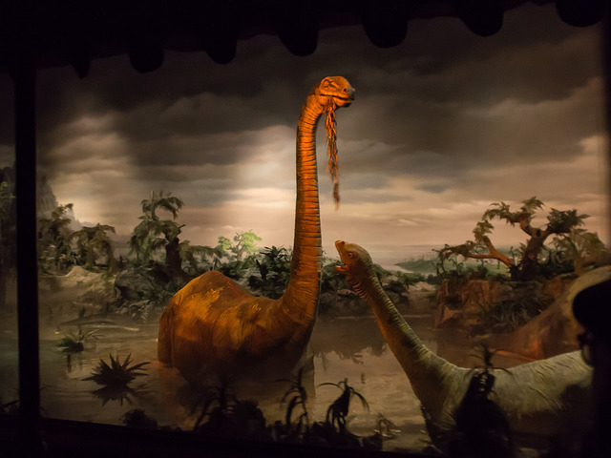
A change in thinking…
“The world is faced with challenges in all three dimensions of sustainable development—economic, social and environmental. More than 1 billion people are still living in extreme poverty, and income inequality within and among many countries has been rising; at the same time, unsustainable consumption and production patterns have resulted in huge economic and social costs and may endanger life on the planet.”
Department of Economic and Social Affairs (2013), World Economic and Social Survey 2013, Accessed 05/01/2018, https://sustainabledevelopment.un.org/content/documents/2843WESS2013.pdf
Image: Flickr, Dinosaur, Javier Castanon, 24/04/2013, Creative commons license, non-commercial, non derivs 2.0 generic.
It’s Official: Scientists Say We're Entering Earth's Sixth Mass Extinction
And humans may struggle to survive it.
FIONA MACDONALD, Science alert,
22 JUN 2015

Slide 11
What is an entrepreneur? 1) On a post-it, or whatever you have to hand, jot down a quick definition of what you think an entrepreneur is. Can you name any? 2) Now write down the skills you think an entrepreneur needs.
Post its

Slide 12
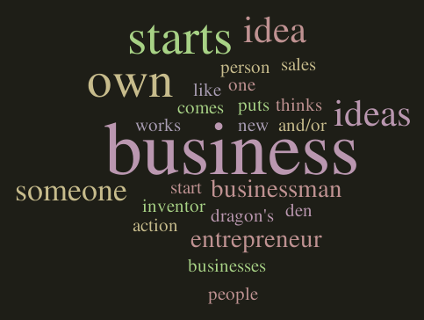
Students from the project pilot schools did the same exercise. Their answers were put into a word cloud and this is the result.
Box on right: entrepreneurial skills that the students should develop as part of the GEE project.
GEE skills: creativity, initiative, tenacity, teamwork, understanding of risk and a sense of responsibility.
This is the entrepreneurial mind-set that helps entrepreneurs transform ideas into action and also significantly increases employability.

Slide 13
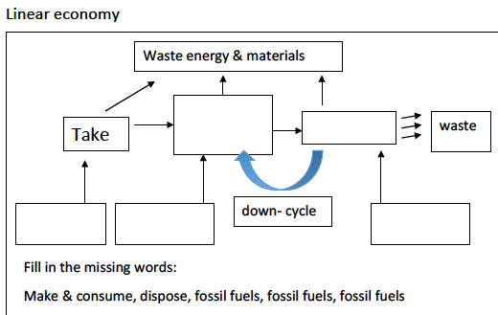
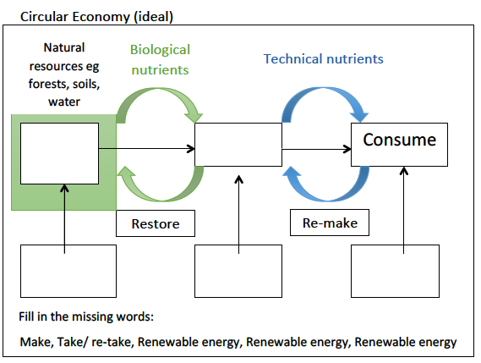
The circular economy
https://www.youtube.com/watch?v=zCRKvDyyHmI up to 2.13
Complete the diagrams
Make & consume
Dispose
Take/ re-take
Make
fossil fuels
fossil fuels
fossil fuels
Renewable energy
Renewable energy
Renewable energy
Images: Originals by Yanika Hennig
Notes:
This is an activity that the students did as part of their introductory module at school.

Slide 14
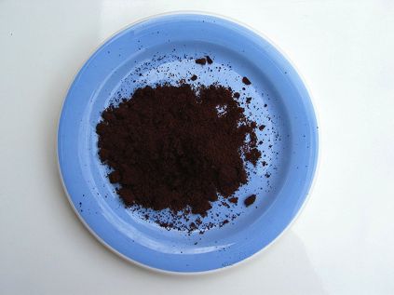
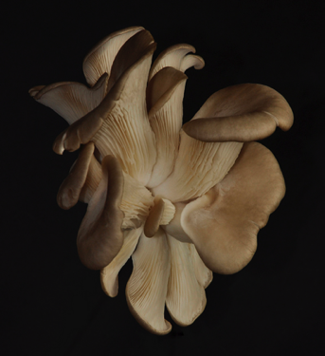
GEE will give students opportunities to
Move away from reductionist to systems thinking (transformative learning).
Not do less bad…but do good! Watch the following clip of a TED talk by well respected supporter of the circular economy William Mc. Donough (from 16.40 mins- end)
https://www.ted.com/talks/william_mcdonough_on_cradle_to_cradle_design#t-4767
By learning the principles that make nature sustainable, we can apply the same principles towards entrepreneurship to create new business ideas and job opportunities that meet Europe’s need for a green economy.
Eg waste = food: coffee ground →mushrooms.
Students will get the opportunity to learn outside the
classroom and engage in real world thinking.
Image:RT, coffee_grounds, Flickr, 01/06/2016, Creative commons license, 2.0 generic. https://creativecommons.org/licenses/by/2.0/
Image: Susanne, oyster mushroom, Flickr, 12/11/2010, Creative commons license, 2.0 generic. https://creativecommons.org/licenses/by/2.0/

Slide 15
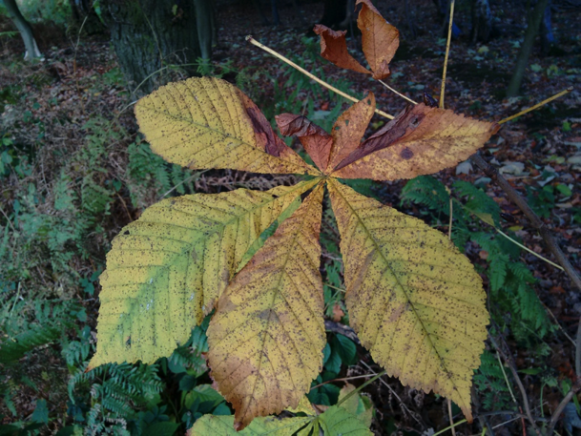
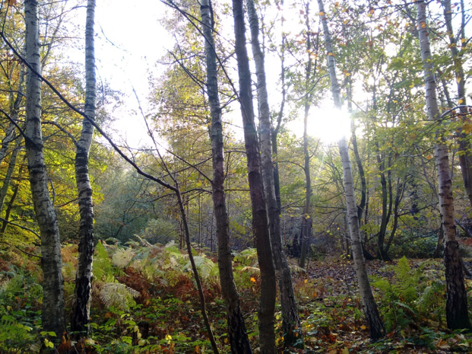
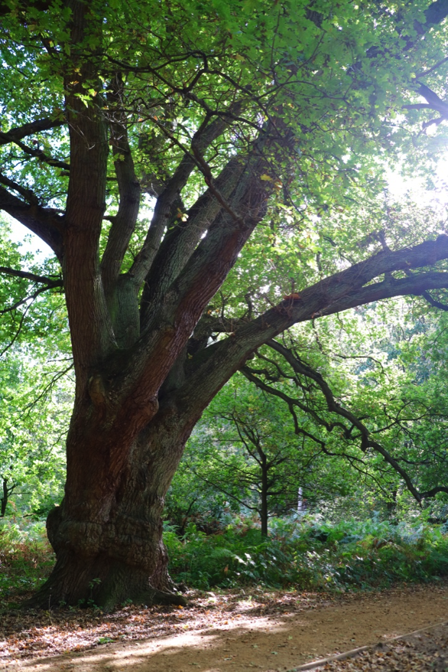
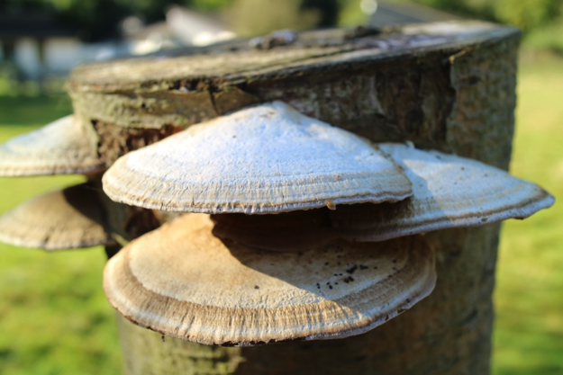
Multiple benefits
One concept that is examined is that nature provides ‘multiple benefits’. When the following scenario is done with students, it takes place outside in a woodland and they are given equipment to investigate trees. If you don’t have trees near you, then look at the images on this slide for inspiration.
Scenario:
A company has drawn up a proposal to the City of London who manage Epping Forest to replace the trees with a type of concrete tree.
Benefits of concrete trees include: generating oxygen, made from strong concrete which won’t blow down, won’t make a mess or drop branches (no injuries), they’re surrounded by easy-walk concrete flooring, come in a choice of sizes, shapes and textures and have huge advertising potential.
You have been tasked by the City of London Ecology department to investigate if this is a good investment, or if trees bring us other benefits.
Write down all the benefits of trees that you can think of.
Now watch this clip, from 10.49 mins- 11.30mins : https://www.ted.com/talks/william_mcdonough_on_cradle_to_cradle_design#t-4767
Images: Yanika Hennig

Slide 16
GEE pedagogy

Slide 17
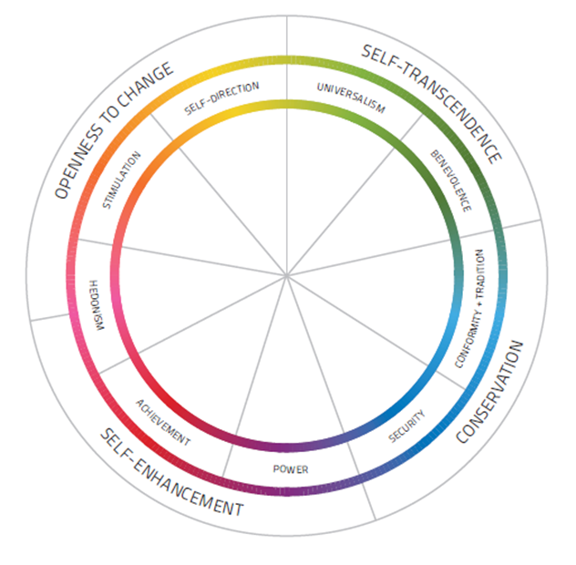
GEE pedagogy and values
Using the Common Cause research, GEE has identified five main values that need to be strengthened as follows:
Unity with Nature – fitting into nature.
Broadminded – tolerant of different ideas and beliefs.
Creativity – uniqueness, imagination.
Influential – having an impact on people and events.
Protecting the environment – preserving nature.
These values will underpin the approach taken to developing and delivering GEE.
Notes:
Common cause: Resulting from decades of international research and cross-cultural studies 58 universally re-occurring value items have been identified that have then been arranged statistically into ten value groups

Slide 18
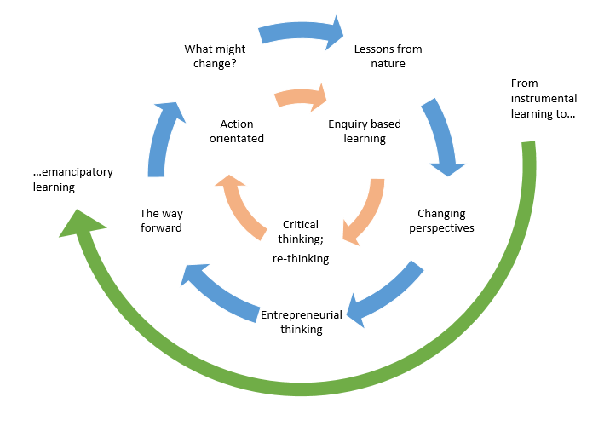
GEE pedagogy
GEE stage
What might change | Students consider their own competencies in relation to entrepreneurship and the green economy. Students reflect: how sustainable is my lifestyle?
Lessons from nature | Students are presented with a situation which leads them to question or investigate how nature works.
Changing perspective | Exploring their challenge starts a process of gathering information about how nature works as opposed to how business usually works
Entrepreneurial thinking | Students use their results to start re-thinking their view on entrepreneurship and business.
The way forward | Students are invited to test their ideas and check how confident they are of their new understanding.
What might change | Students consider their solution and how it might be different over time, in different places, for different people of as the learners change. It may raise a series of new questions which lead onto the next challenge..and so the journey continues at a new level.

Slide 19
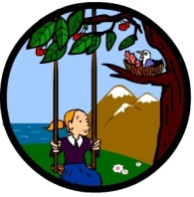
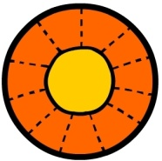
GEE pedagogy
The entrepreneurial learning aimed for within GEE is:
Personal development: building confidence, foster a desire to achieve and inspire action for the green economy.
Entrepreneurial skill development: social skills, networking, creative problem solving, opportunity seeking, group leadership, and community cooperation.
Waste = Food
Multiple benefits
Run on solar income
Diversity gives strength
Nature optimises
Nature is adaptive, dynamic and responsive

Slide 20
Inspiring companies
Here are short clips showing some of the companies that are embracing ideas to do with the circular economy. Watch and decide which ‘lessons from nature’ principles they are addressing (principles on previous slide).
Ecovative: traditional plastic packaging made from mushrooms.
https://www.youtube.com/watch?v=zw2O1PhrzA0
Entocycle: turning organic waste into animal feed, using grubs
https://www.youtube.com/watch?v=PR99xebr_bs
Seabin: a novel way to clear up marine pollutions
https://www.youtube.com/watch?v=PR99xebr_bs

Slide 21
GEE learning pack A brief outline of each stage of the learning pack. For more detail, see the website: www.geelearning.eu

Slide 22
The learning pack
Five main stages:
1: Introductory module, must be done at school BEFORE the outdoors day: (What might change?)
2: Day outdoors (Lessons from nature)
3: Students exposed to existing circular business and start to come up with ideas. (Changing perspectives)
4: Students apply lessons from nature principles and the skills and knowledge they have gained to design their own circular business/ service. (Entrepreneurial thinking
5: Students reflect on their design and those of others and think about: what might change? So the cycle continues

Slide 23
Module 1 What might change? (Introductory module) Location: school 1 -2 lessons required
In this module…
Students calculate their carbon footprint (online as homework)
Class feedback: how can we reduce our carbon footprints?
Introduce project. Students self assess their competencies relating to the green economy/ entrepreneurship
Students start their key word glossary. Add to this throughout the entire project
Introduce circular economy via 1 min video
Students create a bottle biome.
See link in notes section for lesson plan
Notes:
To look at this lesson plan, please go to: www.geelearning.eu Click on ‘Learning materials’ and ‘modules’ Scroll down until you find this module (https://www.geelearning.eu/learning-materials/modules/)
Overview of all modules: : www.geelearning.eu → Learning materials → Modules → how to teach GEE and guide for adaptation document

Slide 24
Outcome from introductory module
Students understand the problem: limited resources, current emphasis on ‘doing ‘less bad’ than ‘doing good’.
Students understand how they contribute to the problem in their everyday lives
Students to start becoming familiar with key words
Students start to think about how nature is circular…..
So that by the time students come to do their fieldwork day, they have an understanding of the topic. This can then be built on.

Slide 25
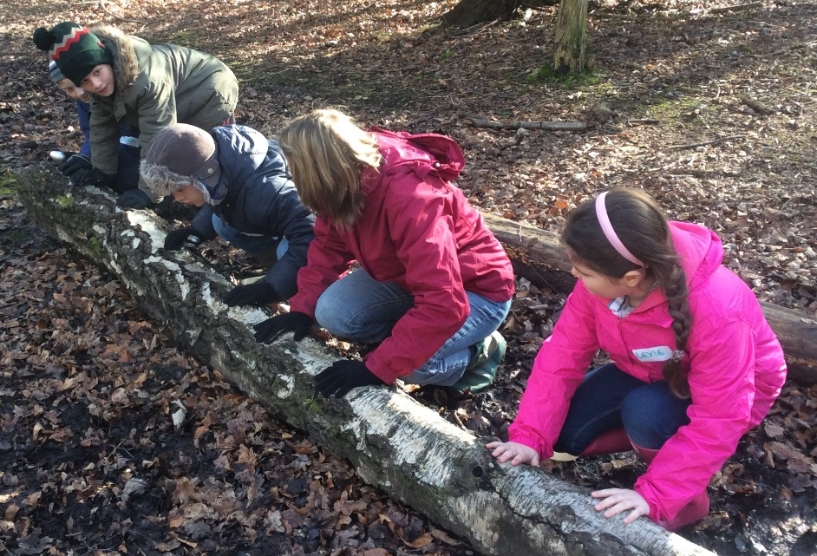
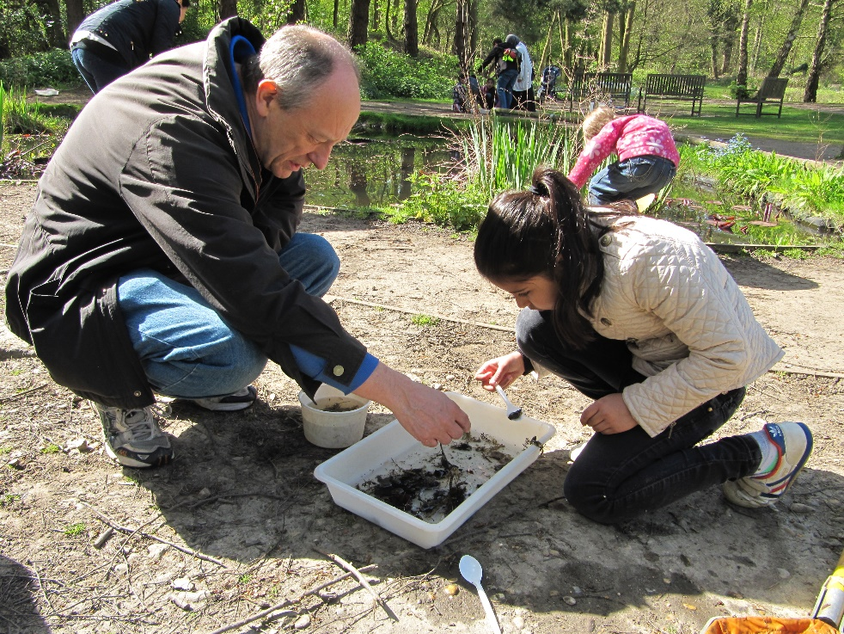
Module 2 Lessons from nature Location: varies depending on module chosen 1 school day required.
For ‘Lessons from nature’, you can pick one of 5 options on a variety of topics. All of these involve teaching outside. There is also the option to book an lfn day at FSC Epping Forest or FSC London, see notes for details.
Lessons from nature principles are demonstrated through hands-on outdoor learning.
The activities vary depending on the option chosen, but will all involve students experiencing different environments outside, getting their hand dirty, and learning how nature does things and how they could incorporate these ideas in their green business designs.
Images: FSC staff Epping Forest
Notes:
Please see website for more informational
Overview of all modules: : www.geelearning.eu → Learning materials → Modules → how to teach GEE and guide for adaptation document
Lesson from Nature lesson plans: www.geelearning.eu → Learning materials → Modules. All 5 lessons from nature lesson plans are there. See the start of each lesson plan for a summary of what that lesson involves.
Resources: all the resources you require to teach each of the ‘lessons from nature’ option can be found under: www.geelearning.eu→ Learning materials → Resources & booklets → choose the relecant option. This is also where you can find the booklet that students fill out.

Slide 26
Outcome from lessons from nature module
Students have experienced ‘learning outside the classroom’.
Students have had a ‘hands-on’ experience with nature/ sustainable development and have seen and experienced concepts in real life.
Students can compare natural cycles (no waste) with human-made waste streams (eg recycling/ landfill)
Students can explain that the energy that drives natural cycles is renewable, whereas man-made cycles are not.
Students have seen examples of green business and understand how these link to natural principles

Slide 27
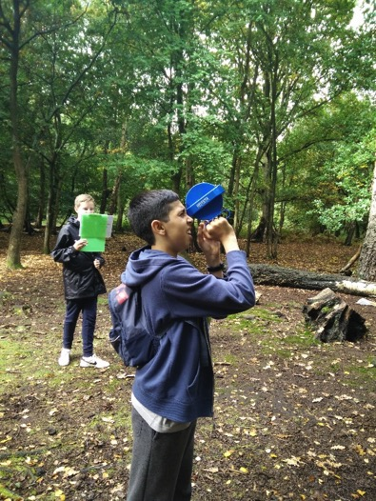
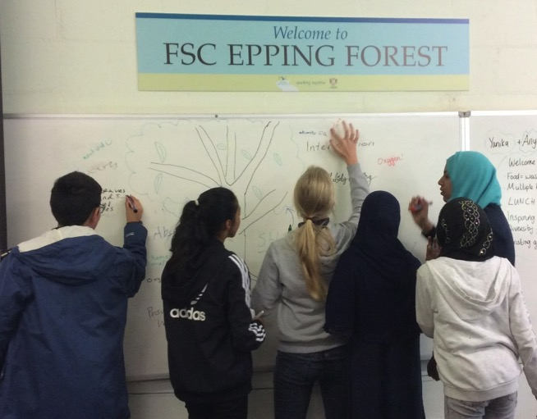
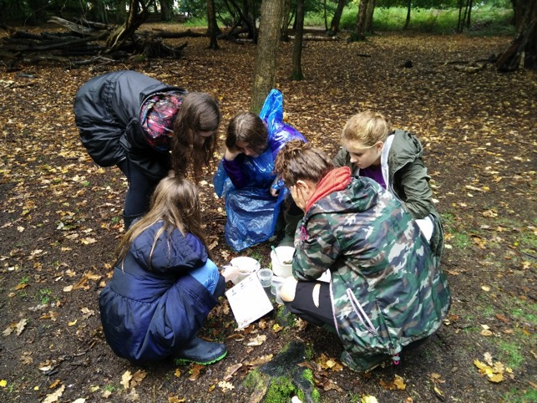
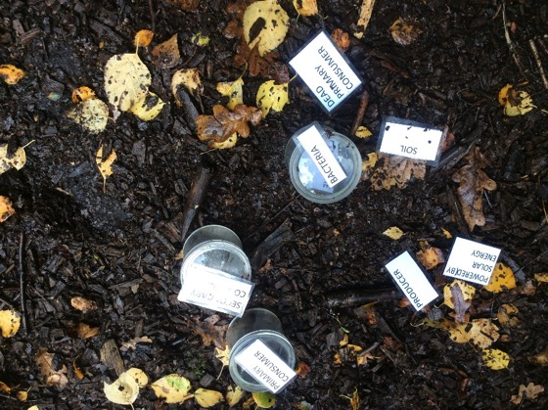
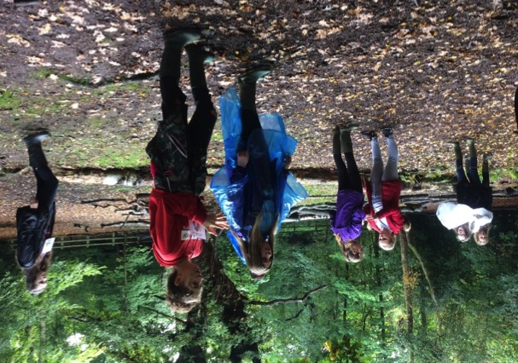
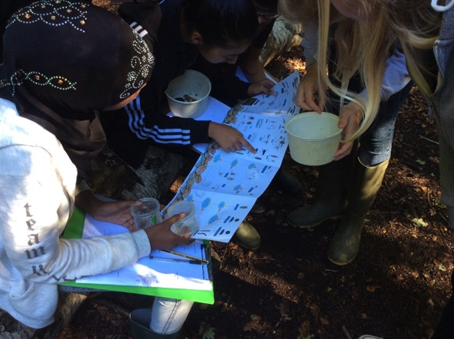
Lessons from nature
Images: FSC staff Epping Forest
Notes:
Photos from the 2 pilot schools that came to Epping for their ‘Lessons from Nature’ day.

Slide 28
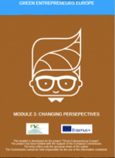
Module 3 Changing perspectives Location: school & CHC venue 1 – 2 lessons + homework
Students complete an e-learning module on business planning.
Students look at case studies of green, circular business in small groups (downloadable from website). Using this information, they answer key questions on the business, eg target audience, competitors, what makes it green etc.
Each group presents back to the class what their findings are.
Either during this module, or the next, students will take part in a coffee house challenge (see notes below).
Notes:
Please see website for more informational
Overview of all modules: : www.geelearning.eu → Learning materials → Modules → how to teach GEE and guide for adaptation document
Module 3 learning pack: www.geelearning.eu →Learning materials → Modules → Module 3 changing perspectives
Case studies: www.geelearning.eu → Case studies (scroll across, there are 12 in total to choose from)
Information about coffee house challenge: : www.geelearning.eu → Learning materials → Modules → Planning a Coffee house challenge

Slide 29
Outcome from changing perspectives
Students exposed to real businesses producing goods and services within the green/ circular economy.
Students can describe the steps involved in business planning.
Students start to critically analyse businesses thinking about a variety of aspects, eg what makes it circular? How green is it? etc

Slide 30
Module 4 Entrepreneurial thinking Location: school 2 lessons + homework
In small groups students come up with a green business idea and develop a business plan around this.
Continue for homework.
Following lesson: students ‘pitch’ their ideas to the class, taking questions at the end. Students will need to demonstrate how their product is circular and incorporates the ‘lessons from nature’ principles.
Notes:
Please see website for more informational
Overview of all modules: : www.geelearning.eu → Learning materials → Modules → how to teach GEE and guide for adaptation document
Module 4 & 5 learning pack: www.geelearning.eu →Learning materials → Modules → Modules 4 & 5 Entrepreneurial thinking and The way forward.
Help for developing business ideas: www.geelearning.eu →Learning materials → Modules → Business planning guidelines

Slide 31
Outcome from entrepreneurial thinking and the way forward
Students inspired to develop their own ideas
Students able to write a basic plan for their idea
Students able to explain their idea to their peers

Slide 32
5 The way forward
Location: school 1 lesson
Students re-visit their self-assessment to see how their skills, knowledge and competencies have changed since the start of the project.
Students think about the future of their product
Students make an eco-pledge: one small change they will make to live more sustainably.

Slide 33
Lessons from Nature day: “The kids loved it and I think it really helped them understand the underlying concepts behind the GEE course much better”. Teacher.
“I enjoyed being able to interact around the forest and being able to turn things from the forest into an idea for a product”. Student
“I have overcome my fear of bugs, and now I can find them with confidence”. Student.
“I have learnt how to make some business ideas and how to make it into real business”. Student.
“I have learnt that recycling delays the process of landfill”. Student
“When you’re done with a wooden ruler, you can carve it into a spoon”. Student
Notes:
Quotes from students and teachers who took part in the GEE project.

Slide 34
Assessment and European Quality Framework

Slide 35
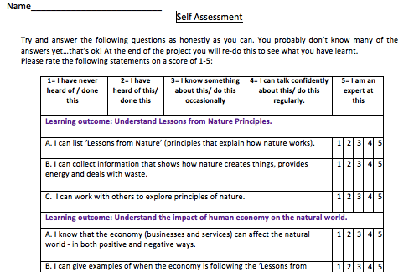
Assessment and EQF
The GEE Framework is a practical overview of the learning GEE will deliver, based on the European Qualifications Framework (EQF)
Students will need to complete an initial self-assessment, demonstrating their knowledge, skills and competencies relating to entrepreneurship and the green economy. This is in the student booklet which you will download once you have decided which lesson from nature day you want to do.
They will re-visit this self-assessment at the end of the project, re-doing each of the questions in a different colour to see what they have achieved.
Within the learning pack, assessment ideas are included, although teachers are welcome to adapt and use their own as they wish.
There is also a template which teachers can use to assess students, see notes below
Notes:
Student self-assessment. This is found in the booklet. The booklets are adapted to the different ‘lessons from nature’ days. Download them from:
www.geelearning.eu → Learning materials → Booklets and resources → select which option you want.
Teacher’s assessment of students:, www.geelearning.eu → Learning materials → Assessment tool for teachers option.

Slide 36
The self assessment and teacher assessment tools are based on the GEE pedagogy framework. This is split into knowledge, skills, competencies and values. The self assessment used in the learning packs is based on the European Quality Framework level 2.

Slide 37
GEE website

Slide 38
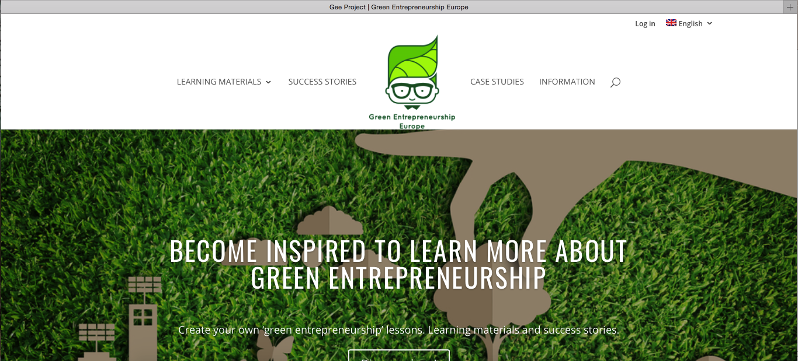
Website
www.geelearning.eu
It is split into 4 main sections:
Learning materials. This is where everything you need to teach GEE can be found.
Success stories. Some of the inspiring stories from the piloting stage of the project. Read to get inspired and get ideas.
Case studies.12 case studies of existing green and circular businesses. They are used to inspire students in module 3.
Information. News updates about the project.

Slide 39
Further reading and useful links

Slide 40
Further reading: websites, see page 41 for videos
Background information
The Ellen Mc. Arthur Foundation website, one of the key promoters of the circular economy
https://www.ellenmacarthurfoundation.org
A website with detail on how to design products in a circular way
http://www.circulardesignguide.com/
A simple, great example of a UK circular economy based product: concentrated cleaning products to which simply tap water is added
https://www.splosh.com
London’s take on the circular economy
https://www.london.gov.uk/city-hall-blog/what-circular-economy-means-london
Ikea pledges to run on 100% renewable energy
https://www.theguardian.com/sustainable-business/2016/apr/08/renewable-energy-ikea-walmart-google-mars-hp-wind-solar-power
Textile dissambly: removing logos from clothes, allowing them to be reused
http://www.ctechinnovation.com/collaborative-research/wear2-microwave-textile-disassembly/
Website explaining and promoting the importance of learning outside the classroom
http://www.lotc.org.uk
continued on next page……..

Slide 41
Other useful websites
FSC Epping Forest/ London where you can book a ‘lessons from nature’ day.
Epping Forest
https://www.field-studies-council.org/centres/londonregion/eppingforest/learn/schools/course-information/secondary.aspx
London https://www.field-studies-council.org/centres/londonregion/london/learn/schools/course-information/secondary.aspx
Business in the Community- our project partners who designed the e-learning and arranged business contacts:
https://www.bitc.org.uk
Next page for videos…

Slide 42
Further reading: videos
RE-thinking the process: the circular economy
https://www.youtube.com/watch?v=zCRKvDyyHmI
A short video imaging a chair that never needs to be thrown away
https://www.youtube.com/watch?v=FKjJyus6WOg
TED talk, William Mc. Donough
https://www.ted.com/talks/william_mcdonough_on_cradle_to_cradle_design
The EU stand on the circular economy. Some examples of use by companies
https://www.youtube.com/watch?v=lK00v_tzkCI
The making of a young entrepreneur: a very honest and relatable young entrepreneur talks about giving back to society
https://www.youtube.com/watch?v=EblQj_pZFlQ

Slide 43
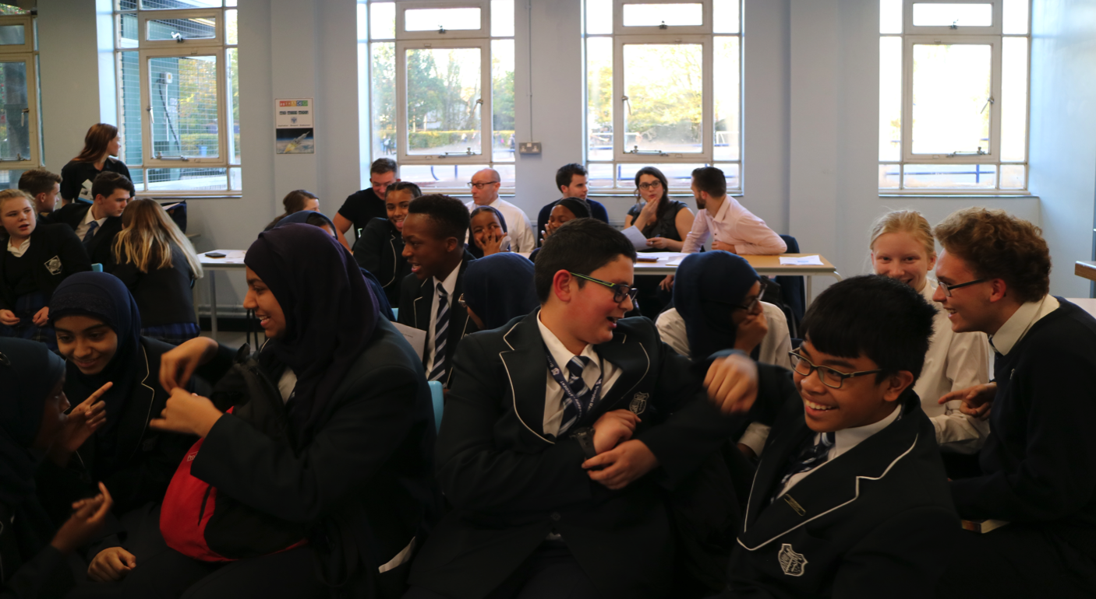
Thank you for reading this guide..
We hope you feel inspired to run a Green Entrepreneurs project at your school!
See separate download ‘clips from the Coffee House Challenge’ for a taste school & business presentations (www.geelearning.eu→ Learning materials→ Modules
Image: Yanika Hennig

